Slide 1
GITHUB BASICS
BY LAEEQ AHMED

Slide 2
What is a GIT Repository ?
Repositories act as essential places for storing the files while maintaining the versions for development.
By using GitHub repositories, developers can organize, monitor, and save their changes of code to their projects in remote environments.
The files in GitHub repository are imported from the repository into the local server of user for further updates and modifications in the content of the file.

Slide 3
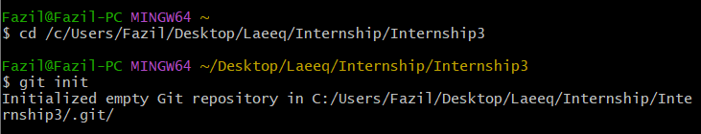
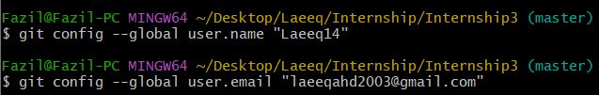
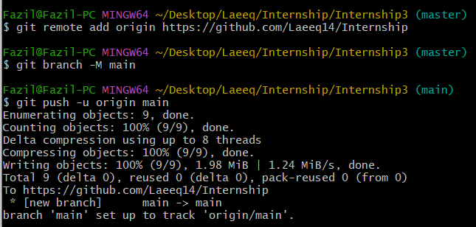
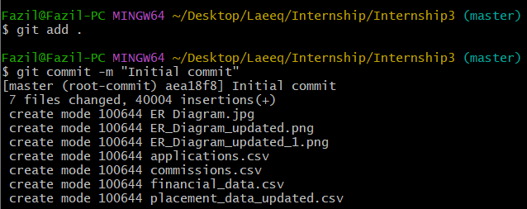
Creating a Repository (using Git Bash)
1. Navigation to project folder and initialization of Git
2. Configuration of Git User
4. Pushing to GitHub
3. Adding files to Git and committing your changes

Slide 4
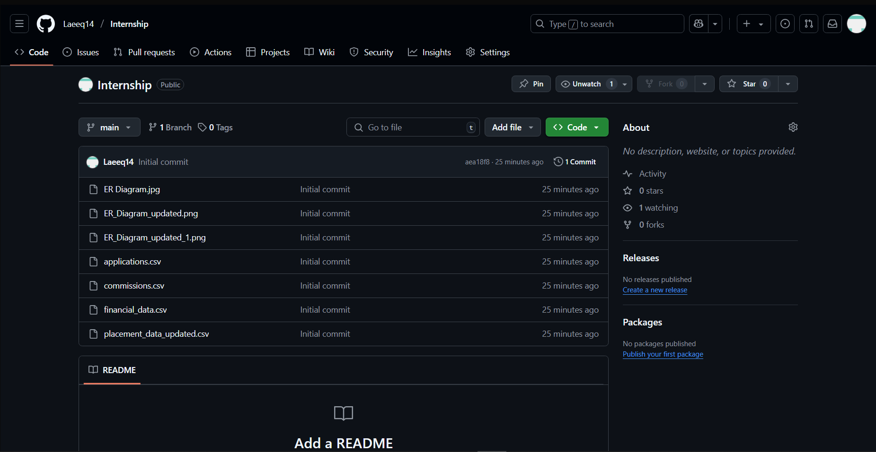
Modification and Addition of new files
git add .
git commit -m "Your commit message"
git push origin main
Changes on GitHub

Slide 5
git reset (Rewrites History)
Moves the HEAD and branch pointer backward to a previous commit.
Removes commits from history (can be dangerous if already pushed).
Command | Effect
git reset –soft <commit> | Moves HEAD back but keeps changes staged (preserves git add)
git reset --mixed <commit> (default) | Moves HEAD back and unstages changes, but files remain.
git reset --hard <commit> | Moves HEAD back and deletes changes permanently.

Slide 6
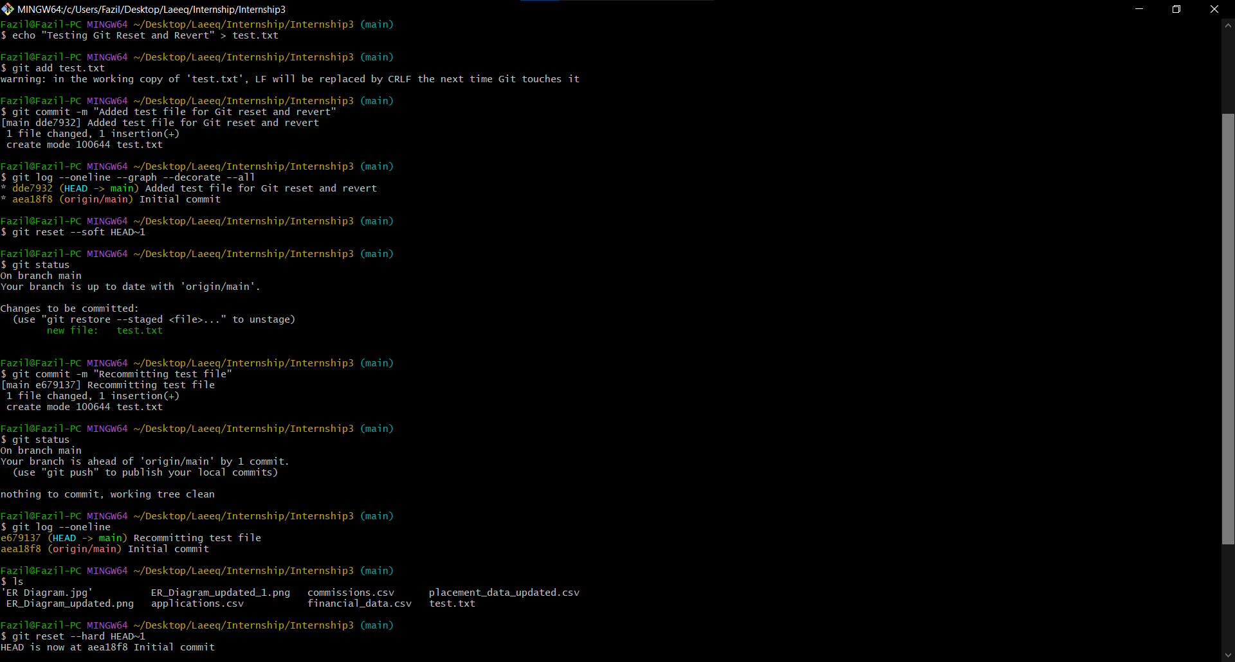

Slide 7
git revert (Safer Undo)
Creates a new commit that undoes a previous commit.
Does not delete history, making it safer for shared repos
Example: git revert HEAD
This creates a new commit that undoes the changes from HEAD.
Unlike reset, previous commit remains in history.
When to Use What ?
Use Case | Command
Undo a local commit before pushing | git reset --hard HEAD~1
Undo a commit without deleting changes | git reset --soft HEAD~1
Undo a commit after pushing (safe) | git revert HEAD

Slide 8
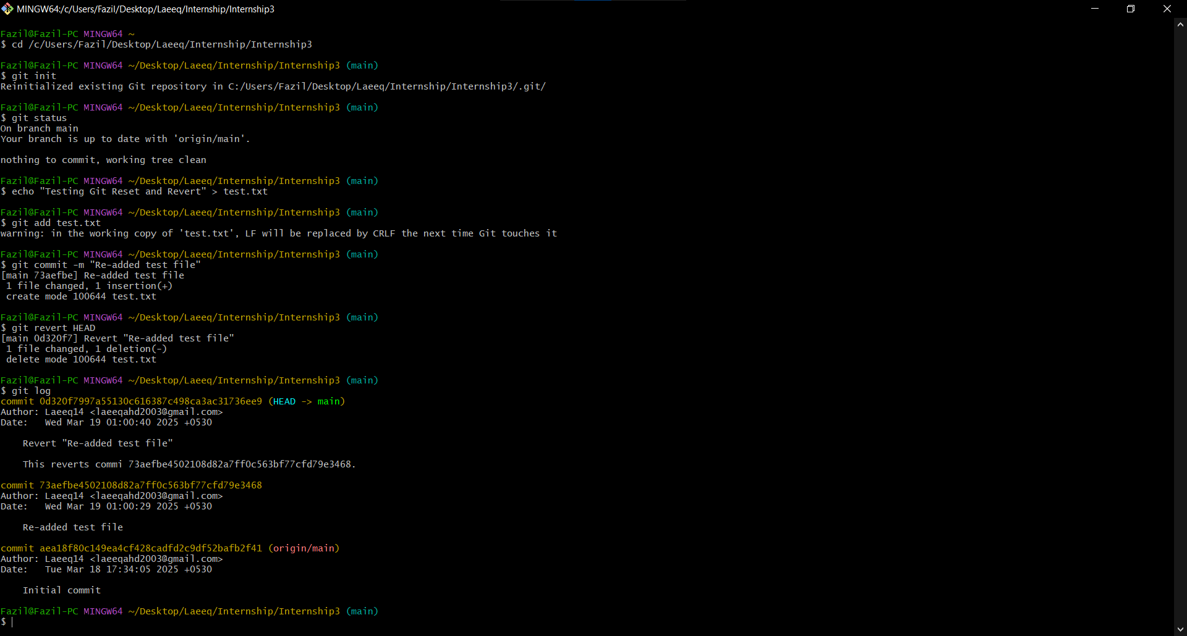

Slide 9
Git rebase
Used to reapply commits on top of another branch.
It helps keep a cleaner commit history by moving (or "replaying") commits onto a new base.
Keeps history linear (unlike git merge, which creates extra merge commits).
Useful for updating your feature branch with the latest changes from main.
Helps rewrite commit history to squash, edit, or reorder commits.

Slide 10
1. Basic Rebase: Move a Branch to the Latest main
# Switch to the feature branch
git checkout feature-branch
# Rebase onto the latest main branch
git rebase main
2. Interactive Rebase: Edit History (git rebase -i)
git rebase -i HEAD~3
This opens a list of the last 3 commits in a text editor.
You can squash (combine), edit, or drop commits before saving.
3. Avoiding Issues with git rebase
Do NOT rebase a branch that has already been pushed to a shared repository. If already pushed, use:
git push --force
.

Slide 11
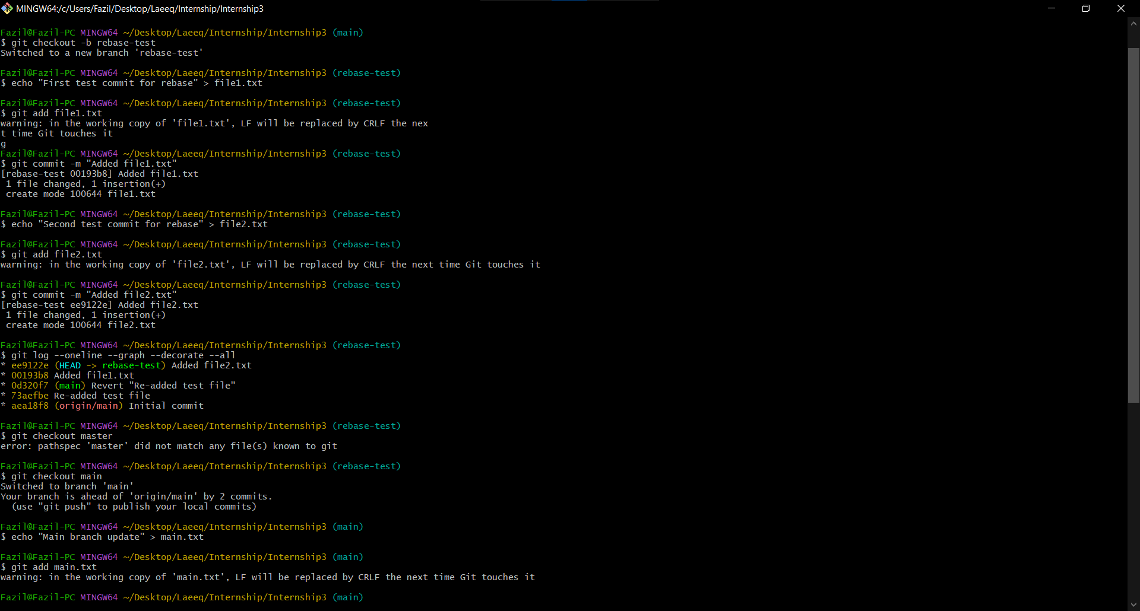

Slide 12
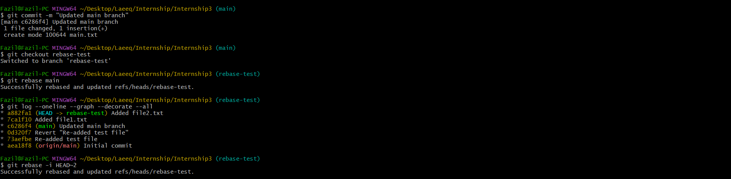
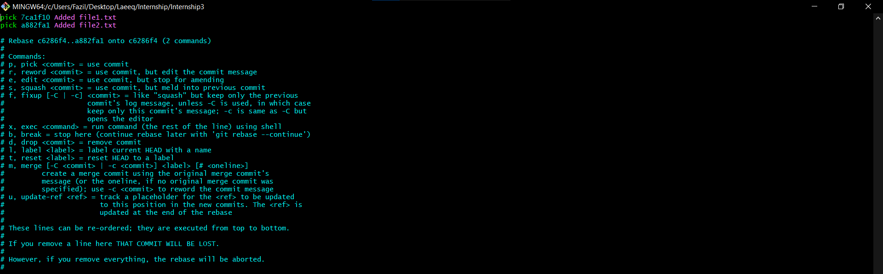

Slide 13
1. git clean –n (Dry Run) – Safe Mode
git clean – Removing Untracked files
git clean is used to delete untracked files from your working directory. These are files that are not staged (git add) or committed.
Shows a preview of which untracked files would be deleted without actually deleting them.
This is a safe way to check before running the actual cleanup.
2. git clean –f (Force Delete)
Actually deletes the untracked files that git clean -n previewed.
WARNING: This cannot be undone, so use -n first.
3. Additional git clean functions
git clean -fd removes both untracked files and directories.
git clean -fx deletes everything, including ignored files.

Slide 14
Basic Git Commands
Command | Description
git init | Initialize a new Git repository.
git clone <repo_url> | Clone a repository from a remote source.
git status | Show the current state of the working directory.
git add <file> | Stage a specific file for commit.
git add . | Stage all changes in the working directory.
git commit -m "Message" | Commit staged changes with a message.
git commit –amend | Modify the last commit message.

Slide 15
Working with branches
Command | Description
git branch | List all branches.
git branch <branch-name> | Create a new branch.
git checkout <branch> | Switch to a branch.
git checkout -b <branch> | Create and switch to a new branch.
git merge <branch> | Merge another branch into the current branch.
git branch -d <branch> | Delete a branch (safe if merged).
git branch -D <branch> | Force delete a branch.

Slide 16
Working with Remote Repositories
Command | Description
git remote -v | Show remote repositories.
git remote add origin <url> | Link a remote repository.
git push origin <branch> | Push changes to a remote branch.
git push origin --force | Force push (use with caution).
git pull origin <branch> | Fetch and merge changes from a remote branch.
git fetch origin | Fetch changes without merging.

Slide 17
Undoing Changes
Command | Description
git reset <file> | Unstage a file (move from staged to unstaged).
git reset --soft HEAD~1 | Undo the last commit but keep changes staged.
git reset --mixed HEAD~1 | Undo the last commit and unstage changes.
git reset --hard HEAD~1 | Undo the last commit and discard changes permanently.
git revert <commit> | Create a new commit that undoes a previous commit.
git checkout -- <file> | Discard local changes to a file.

Slide 18
Viewing and Comparing Changes
Command | Description
git log | Show commit history.
git log --oneline | Show commit history in a short format.
git log --graph --decorate --all | Show a visual commit tree.
git diff | Show unstaged changes.
git diff --staged | Show staged changes.
git show <commit> | Show details of a specific commit.

Slide 19
Stashing and Cleaning
Command | Description
git stash | Save current changes without committing.
git stash pop | Reapply the last stashed changes.
git stash list | Show all stashed changes.
git stash drop | Delete a specific stash.
git clean -n | Show untracked files that would be deleted.
git clean -f | Delete untracked files.

Slide 20
GitHub Features
1. Version Control & Repository Management
Feature | Description
Repositories (Repos) | Central storage for project files, commits, and branches.
Branches | Create different versions of code for development and testing.
Commits & History | Track code changes with detailed commit messages.
Pull Requests (PRs) | Propose changes from one branch to another and request review.
Merge & Rebase | Combine code changes seamlessly.

Slide 21
GitHub Features
2. Collaboration and Teamwork
Feature | Description
Issues | Track bugs, feature requests, and discussions.
Discussions | Community-driven conversations and knowledge sharing.
Wikis | Document project details, instructions, and FAQs.
Project Boards | Organize tasks using Kanban-style boards.
Code Owners | Automatically assign reviewers based on file changes.
Templates (Issue/PR Templates) | Standardize bug reports, feature requests, and PR descriptions.

Slide 22
GitHub Features
3. Security & Code Quality
Feature | Description
GitHub Actions for CI/CD | Automate testing, builds, and deployments.
Code Scanning | Identify vulnerabilities and security issues.
Secret Scanning | Detect accidental exposure of sensitive data like API keys.
Dependency Graph | Track dependencies and get alerts on security risks.
Branch Protection Rules | Restrict direct pushes and enforce code reviews.
Two-Factor Authentication (2FA) | Enhance account security.

Slide 23
GitHub Features
4. Automation & DevOps
Feature | Description
GitHub Actions | Automate workflows for testing, deployment, and notifications.
Webhooks | Trigger events based on repository actions.
Package Registry | Host and manage software packages like npm, Docker, and Maven.
Auto-Merge | Automatically merge PRs after passing checks.

Slide 24
GitHub Features
5. Automation & DevOps
Feature | Description
GitHub Pages | Host static websites directly from a repo.
Environments & Secrets | Manage configurations securely for deployments.
Codespaces | Cloud-based VS Code environment for instant development.

Slide 25
GitHub Features
6. Enterprise & Organization Management
Feature | Description
Organizations & Teams | Manage users, repositories, and permissions.
Audit Logs | Track actions taken within an organization.
SAML/SSO Authentication | Enterprise-grade security for user access.

Slide 26
Thank You

